Slide 1
CTF model for long reverberation Date：2022. 03. 22
Telecom Electroacoustics Audio(TEA) Lab
Presenter:
Anchi Yuan
Notes:
Hello everyone
I’m today’s presenter siang. I’m going to share some of my present work in source separation problem. My topic is comparative studies of source separation using semi-blind and blind source separation approaches.

Slide 2
Outline
Recursive estimation of CTF
Simulation settings
ATF estimation
Window lengths comparion
Source signal estimation
Conclusion
Future work

Slide 3
Recursive estimation of CTF

Slide 4
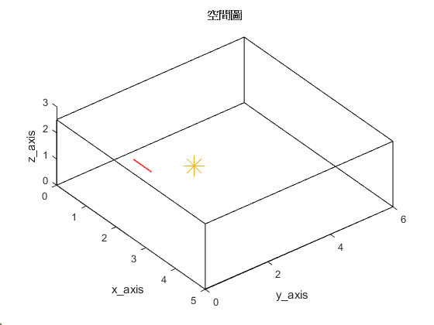
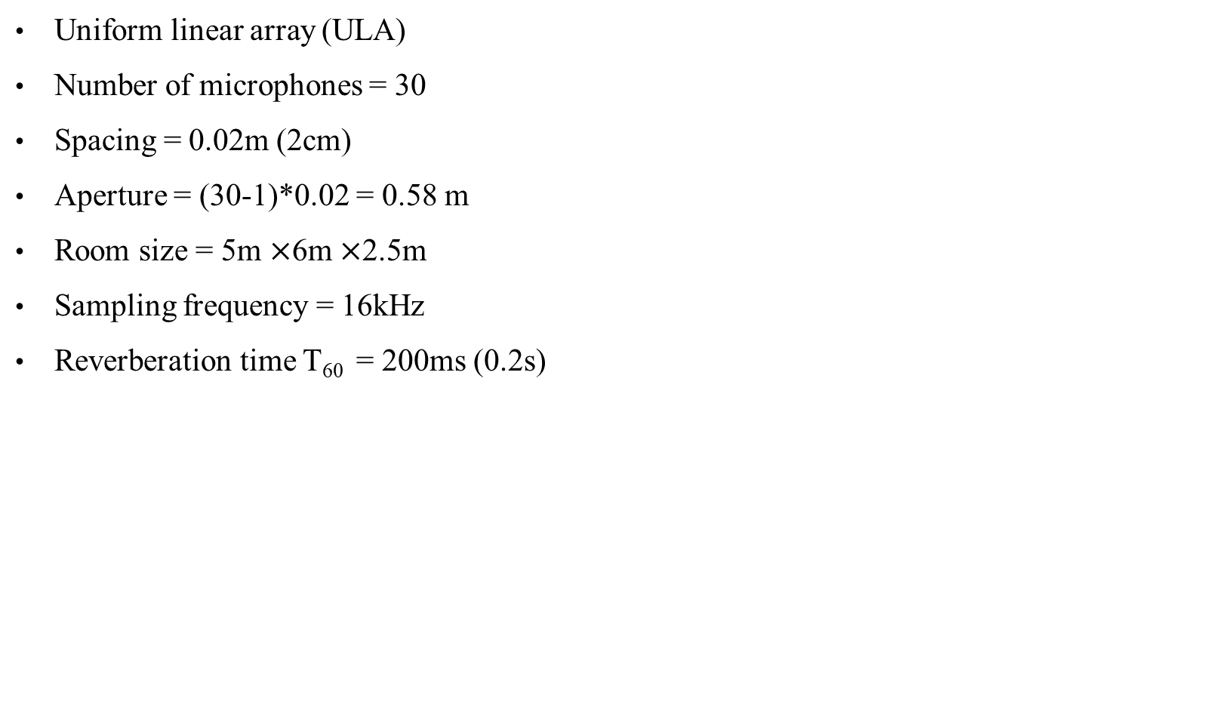
Simulation settings
Uniform linear array (ULA)
Number of microphones = 30
Spacing = 0.02m (2cm)
Aperture = (30-1)*0.02 = 0.58 m
Room size = 5m $×$6m $×$2.5m
Sampling frequency = 16kHz
Reverberation time T₆₀ = 200ms (0.2s)
Array start location [1, 1.5, 1]
2.5m
origin
Source location [2, 2.6, 1]
5m
6m

Slide 5
ATF estimation

Slide 6
Window lengths comparison (1)
 | Window length = 32 | Window length = 64
ATF time domain plot comparison
Matching error | 0.6699 | 0.7467

Slide 7
Window lengths comparison (2)
 | Window length = 128 | Window length = 256
ATF time domain plot comparison
Matching error | 0.7253 | 0.4870

Slide 8
Window lengths comparison (3)
 | Window length = 1024 | Window length = 2048
ATF time domain plot comparison
Matching error | 0.1709 | 0.0817

Slide 9

Source signal estimation
True source
Mic received

Slide 10
Window lengths comparison (4)
True source
 | Window length = 32 | Window length = 64
音檔
True and predicted source time domain plot comparison

Slide 11
Window lengths comparison (5)
True source
 | Window length = 128 | Window length = 256
音檔
True and predicted source time domain plot comparison

Slide 12
Window lengths comparison (6)
True source
 | Window length = 1024 | Window length = 2048
音檔
True and predicted source time domain plot comparison

Slide 13
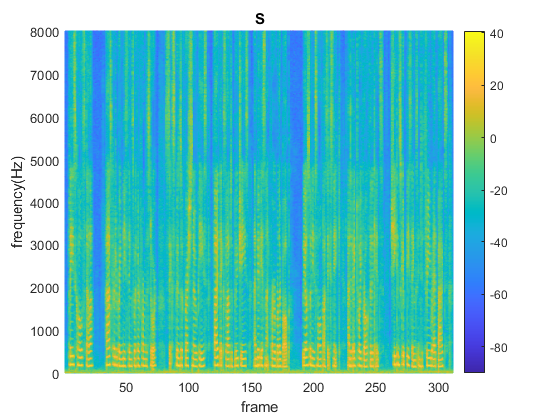
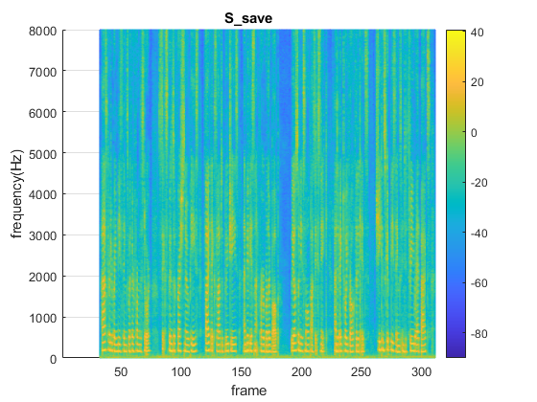
Window lengths comparison (6)
Window length = 2048
True source
predicted source

Slide 14
Conclusion
Long window is better for ATF estimation
Long window is also better for source prediction

Slide 15
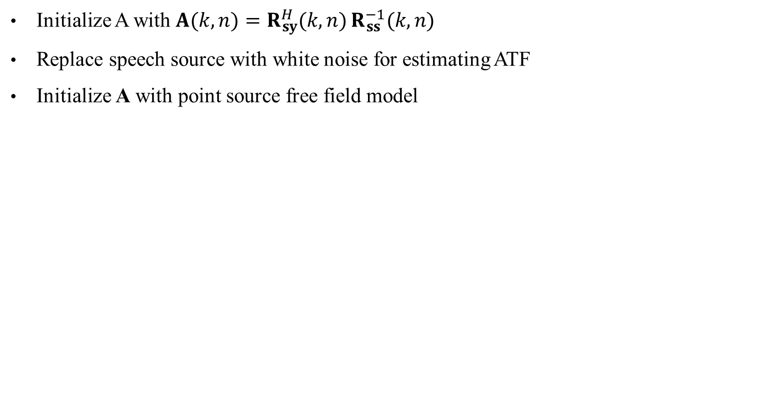
Future work
Initialize A with $\left.\left.A\left.(\right.k,n)\right.=R_{sy}^{H}\left.(\right.k,n)\right.R_{ss}^{−1}\left.(\right.k,n)$
Replace speech source with white noise for estimating ATF
Initialize A with point source free field model

Slide 16


Slide 17
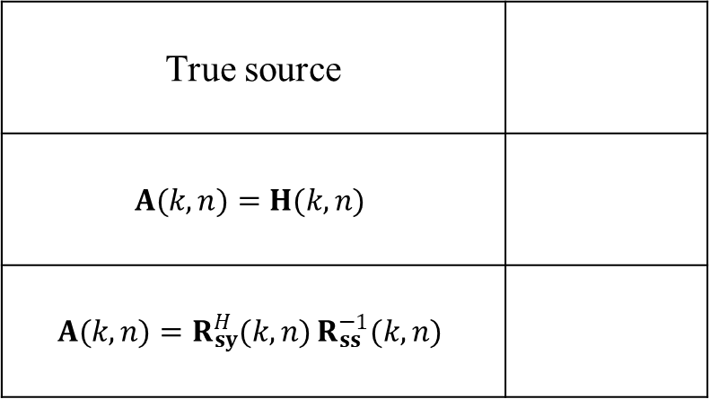
Compare
True source
$$\left.\left.A\left.(\right.k,n)\right.=H\left.(\right.k,n)\right.$$
$$\left.\left.\left.A\left.(\right.k,n)\right.=R_{sy}^{H}\left.(\right.k,n)\right.R_{ss}^{−1}\left.(\right.k,n)\right.$$

